Slide 1
OASIS
A Commercial High Performance Terminal AI Processor
Supporting RISC-V Tensor Extension Instructions
Peng Gao
Beijing University of Posts and Telecommunications
Yang Liu
Beijing University of Posts and Telecommunications
Notes:
Hello everyone, I‘m glad to share our work, OASIS, a terminal SOC that supports RISC-V tensor extension instructions.

Slide 2
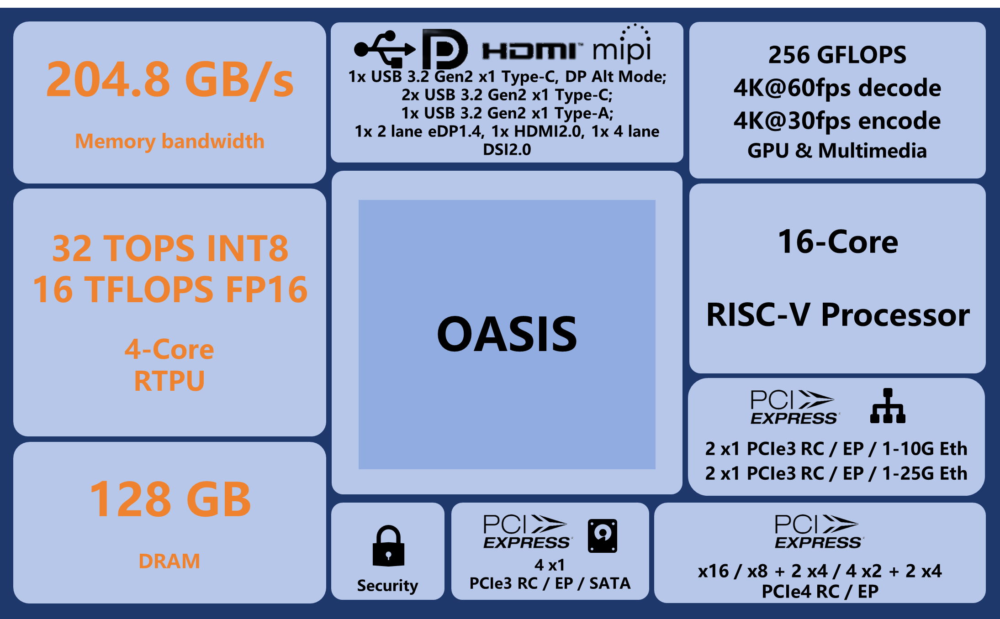









Innovative AI Processor: RTPU in OASIS
RISC-V Tensor Extension ISA
High Computing Power
Support inference for various multimodal AI models
Large Capacity: Supports >200B models with 4-bit Quantization
High Bandwidth: Performance takes off when matching the MOE model
Notes:
Our innovative work is RTPU, which stands for RISC-V Tensor Processing Unit.
It adopts a RISC-V-based tensor extension instruction set.
The high-efficiency computing power provided by RTPU, together with high DRAM bandwidth and large DRAM capacity, enables the SOC chip we designed to provide high-performance support for various multimodal AI models.

Slide 3
Important Factors for AI Oriented Computing
Memory
Control
ISA
Connect
Compute
Notes:
Our point of view is that an excellent AI chip involves five factors of technology.
The first is what Instruction Set Architecture to choose

Slide 4

RISC-V for AI
Why RISC-V for AI?
What’s the problem?
Open
Completely free to use
Current processes
Vector have been standardized and already in commercial use
Matrix is in progress
Scalar
Vector
Matrix
Innovation
Flexible Expansion, Modular Design
the computing efficiency for multimodal AI models
The problem is
4-dim Tensor
（NCHW)
Tensor extension
All data abstracted into tensors
Extra large length
Flexible physical storage layout
Consensus
Consensus and Collaboration Enabled through Standardization
Notes:
RISC-V's characteristics of being open-source, free, easily extensible, and modularly designed make it the most ideal ISA for innovative applications, while various technical explorations can achieve consensus through standardization.
Based on these advantages, we choose RISC-V as the ISA for our AI processor.
Considering the efficient support of multi-modal AI models, we do not adopt the standardized vector extension instructions and the developing matrix extension instructions.
We innovatively define a new set of tensor extension instructions.
In this set of instructions, the main data type is tensor with NCHW four dimensions, featuring extremely large data volume and flexible storage methods.

Slide 5
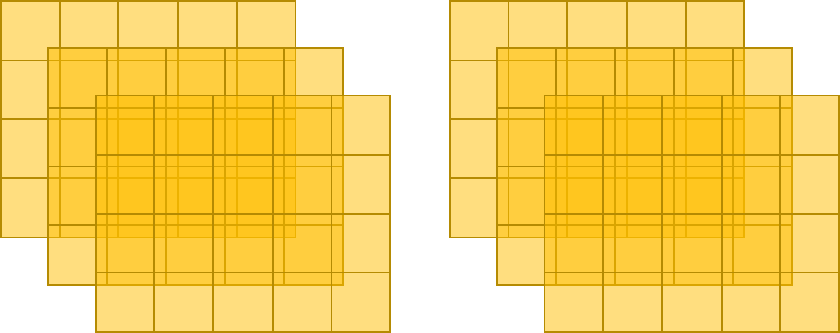

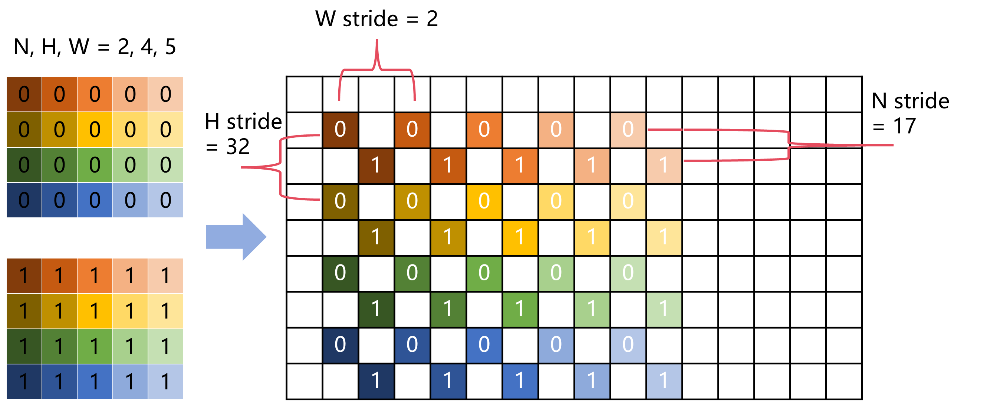
Tensor Extension Registers and Layout
Extension Register
Tensor Layout
4-dim Tensor
（N=2 C=3 H=4 W=5)
LMEM0
LMEM1
LMEM2
SR
（Scalar Register）
CSR
VR
（Vector Register）
Ext-CSR
TCR
（Tensor Constant Register）
3D Tensor’s Layout in One LMEM
TVR
（Tensor Virtual Register）
TR
（Tensor Register）
GVR
（Global Virtual Register）
GR
（Global Register）
Notes:
On the basis of the original registers, we define extended Control & status register, tensor constant register, tensor register, and global register, as well as tensor virtual register and global virtual register defined to specify their sizes, precision, and other attributes.
Due to the large volume of the tensor register, in the implementation, scratch pad SRAM is used instead of flip-flops to store the tensor register
On the right, we show how tensor registers are stored.
RTPU’s scratch pad SRAM are organized into a series of local memories, where different local memories store 3-dimensional tensor slices of different Channel dimension.
A tensor slice with N, H, W dimensions is stored in a local memory by defining the starting address, w stride, h stride, and n stride.

Slide 6
Tensor Extension Instruction
Type | Sub-Type | Function Descriptions | Instruction Numbers
Configure | CSR | Configure Extended-CSR | 9
 | CR / TVR / GVR | Configure CR / TVR for TR’s shapre / GVR for GR’s shapre | 9
Compute | Vector – Element Wise | Element wise operator using vector of CU | 51
 | Vector – Fusion | Fusion operator using vector of CU Full connection Pooling ROI pooling Depthwise convolutions Vector correlation | 22
 | Cube | Compute using cube of CU Convolution Matrix multiplication | 8
Move | Intra TPU Move | Move data intra TPU Broadcast Transpose Mask select Non-Zero index Scatter-gather 2D scatter-gather | 18
 | Move | Move data between vector register and TR | 6
Load / Store | - | Load and store TR Broadcast Transpose Reverse Mask select Non-zero index Scatter-gather | 23
Sync | - | Synchronization between multiple RTPUs | 3
Notes:
We define 5 types of tensor extension instructions including configuration, computation, move, Load/Store, and Sync instructions, totaling 149 instructions.
Many of these instructions provide native support for typical AI operators, such as convolution, depthwise convolution, matrix multiplication, various pooling, transpose, mask select, and non-zero index.
These instructions significantly enhance the computational efficiency of AI model.

Slide 7
Software Stack
TPU-MLIR: High-performance graph compiler based on MLIR
Mainstream AI framework supported
Operator fusion
Operator Tiling and Scheduling
AI
Framework
ONNX
Tensorflow
Pytorch
vLLM/TGI
ollama/
llama.cpp
High Performance Operator Library
TPU-MLIR
Toolchain
Triton
Tile-Lang
C++
Python
High-performance operator library
200+ common AI operators supported
Support for LLVM with Extended Instructions
Runtime Libraries
Driver
Layer
Drivers
Programming language
Various programming language supported
Notes:
The extension instructions based on RISC-V also bring changes to our toolchain
The output of the graph compiler TPU-MLIR is integrated into LLVM, encapsulated into the instructions of the RISC-V CPU.
We also provide support for parallel programming language for AI applications such as Triton and tile-lang.

Slide 8
Important Factors for AI Oriented Computing
Memory
Control
ISA
Connect
Compute
Notes:
The second important factor for AI oriented computing is control, which means how we achieve control over compute units through instructions and coordination among multiple AI processors.

Slide 9
RTPU Architecture 1/2
RTPU
256b
ALU
TIU
CUs
RV64GCV
64-bit RISC-V
VCIX
32x512b
Vector RF
IFE
MVU
TRs
I-Cache
D-Cache
LSU
Private L2 (ECC)
SMMU
SVPU
TPU
  IFE
    Instruction queue
    Instruction decoding
    Dependency check
  MVU
  Data movement between vector register file and TPU
  LSU
  Dedicated Data load and store unit for TPU
  High bandwidth
  TIU
  Compute Instruction decoding and issuing
  TIU for all lanes
Notes:
This is the function block diagram of RTPU, where SVPU is an in-order dual-issue RISC-V CPU that reads all instructions, processes both scalar and vector instructions, and transmits tensor extension instructions through the VCIX interface, which are then executed by the TPU.
IFE module is responsible for instruction queue, instruction dispatch functions, and data dependency checks.
MVU module is responsible for data movement,
and LSU module is responsible for data load and store.
TIU module handles all computations and data transfer instructions within the TPU.

Slide 10
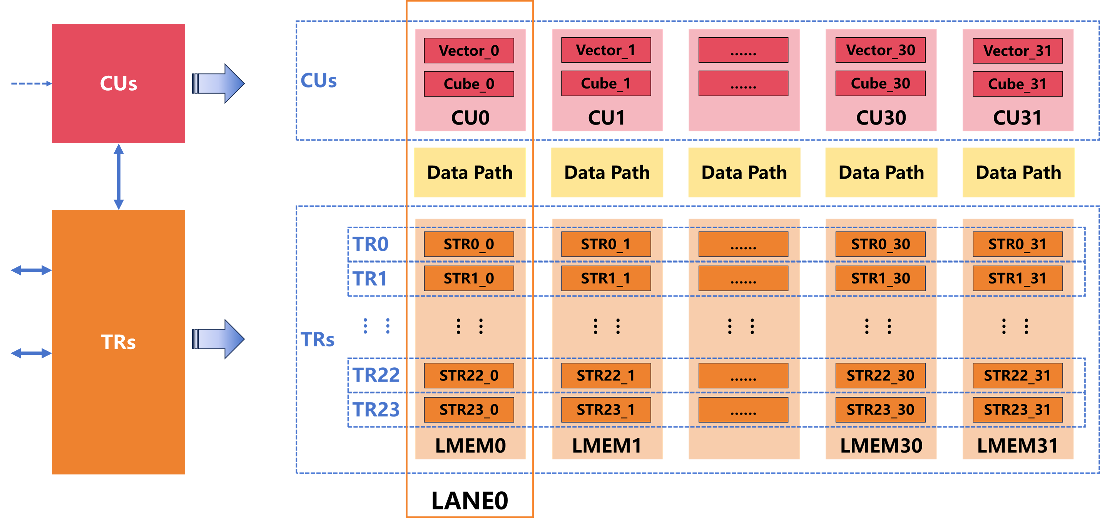
RTPU Architecture 2/2
Data Path0
Data Path1
……
Data Path30
Data Path31
  Logical concept
    TR
  Physical concept
  LANE0 = CU0 + Data Path0 + LMEM0
Notes:
On this page, we will expand on CU, representing compute unit, and TR, representing Tensor register.
We physically divide all the internal data storage SRAM of the TPU into 32 parts
TR is a logical concept consisting of 32 sub-blocks, each of which has the same offset address in each local memory.
Similarly, we divide Compute Unit and Data Path into 32 parts. Each Compute Unit contains vector compute unit and cube compute unit.
In the physical implementation, Compute Unit 0, data path0, and LMEM0 constitute LANE0, and the circuits of all LANEs are completely identical, which greatly facilitates logic design, verification, and physical implementation.

Slide 11
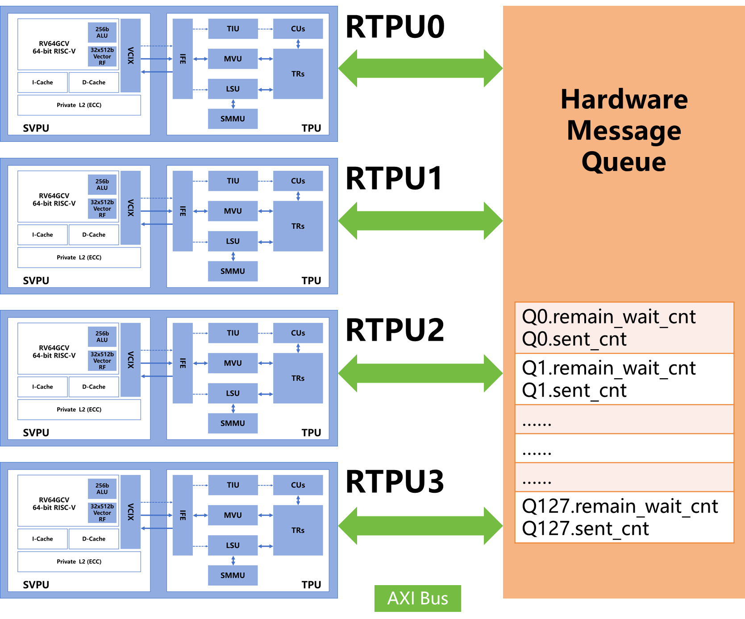
Inter-RTPU Synchronization
Inter-RTPU Synchronization Scheme
Average Latency of a Single Synchronization Event
Synchronization Method | Latency (Cycles) | Primary Bottleneck
Cache-Coherent Atomics (AMO) | ~100-200 | Coherence Protocol, Bus Contention
OASIS Message Queue | ~25 | AXI Bus Round-Trip Time
Pseudocode for Semaphore-based synchronization mechanism
/* the processing function for the GIVE message after it is received by the message queue */
def recv_give ( signal_id , wait_cnt ) {
/* When the first GIVE message is received , initialize the remain_wait_cnt variable */
if ( signal_que [ signal_id ]. remain_wait_cnt ==0)
signal_que [ signal_id ]. remain_wait_cnt = wait_cnt ;
/* for every GIVE message received , increment sent_cnt by one */
signal_que [ signal_id ]. sent_cnt ++;
}
/* the processing function for the WAIT message after it is received by the message queue */
def recv_wait ( signal_id , send_cnt ) {
while ( signal_que [ signal_id ]. sent_cnt != send_cnt )
continue ;
/* send a TAKE message once the current queue ‘s send_cnt matches the send_cnt specified in the WAIT message */
send_take ( rtpu_id , success ) ;
/* if remain_wait_cnt is zero , clear the information associated with that ID */
if ( - - signal_que [ signal_id ]. remain_wait_cnt == 0)
signal_que [ signal_id ] = {0};
}
Notes:
For the sake of multitask support and ease of physical implementation, we set the computing power of one RTPU to 8 TOPS, and then instantiate multiple RTPUs in SOC.
This then brings up an issue: when multiple RTPUs jointly execute an AI model, an efficient synchronization mechanism is required between the RTPUs.
Although synchronization can be achieved through the cache coherent atomic defined by RISC-V, the efficiency of this method is very low, with an overhead of about 100-200 clock cycles.
We design a more efficient hardware synchronization mechanism, reducing the synchronization overhead to around 25 clock cycles.

Slide 12
Important Factors for AI Oriented Computing
Memory
Control
ISA
Connect
Compute
Notes:
The third important factor for AI oriented computing is how to implement the calculation of matrix multiplication and convolution operators that require high computing power.

Slide 13
Introducing Micro-architecture By Convolution
/* During each calculation , produce a total of 128 results by computing 1 ON , 32 OC , and 4 OHW coordinates */
for on in range (0 , ON )
for oc in range (0 , OC , 32)
/* under the same ON and OC dimensions , the results from 64 adjacent OHW coordinates are treated as one group */
for ohw_grp in range (0 , OH * OW , 64)
/* implement the multiply - accumulate operations related to the IC dimension using a 32 - input adder tree */
for ic in range (0 , IC , 32)
for kh in range (0 , KH )
for kw in range (0 , KW )
/* traverse ohw_grp and compute 4 results at a time */
for ohw in range ( ohw_grp , ohw_grp + 64 , 4)
oh[3:0] = F_oh ( ohw + [3:0] , OH , OW ) ; // compute OH coordinate
ow[3:0] = F_ow ( ohw + [3:0] , OH , OW ) ; // compute OW coordinate
/* compute IH coordinate */
ih[3:0] = F_ih ( oh [3:0] , kh , IH , T_PADDING , B_PADDING , IH_INSERT , H_STRIDE , KH , KH_DILATION ) ;
/* compute IW coordinate */
iw[3:0] = F_iw ( ow [3:0] , kw , IW , L_PADDING , R_PADDING , IW_INSERT , W_STRIDE , KW , KW_DILATION ) ;
/* 32 Cube Units , each calculating 4 results */
for i in range (0 , 32)
O[on, oc + i, oh[0],ow[0]] = I [ on , ic : ic + 31 , ih [0] , iw [0]] * K [ ic : ic + 31 , oc + i , kh , kw ] + O [ on , oc + i , oh [0] , ow [0]];
O[on, oc + i, oh[1],ow[1]] = I [ on , ic : ic + 31 , ih [1] , iw [1]] * K [ ic : ic + 31 , oc + i , kh , kw ] + O [ on , oc + i , oh [1] , ow [1]];
O[on, oc + i, oh[2],ow[2]] = I [ on , ic : ic + 31 , ih [2] , iw [2]] * K [ ic : ic + 31 , oc + i , kh , kw ] + O [ on , oc + i , oh [2] , ow [2]];
O[on, oc + i, oh[3],ow[3]] = I [ on , ic : ic + 31 , ih [3] , iw [3]] * K [ ic : ic + 31 , oc + i , kh , kw ] + O [ on , oc + i , oh [3] , ow [3]];
Notes:
We will introduce the cube compute unit using convolution as an example.
This page explains the implementation scheme for convolution on Four-dimensional tensors. The blue part corresponds to the calculations performed by the cube, which is used for convolution and matrix multiplication.

Slide 14
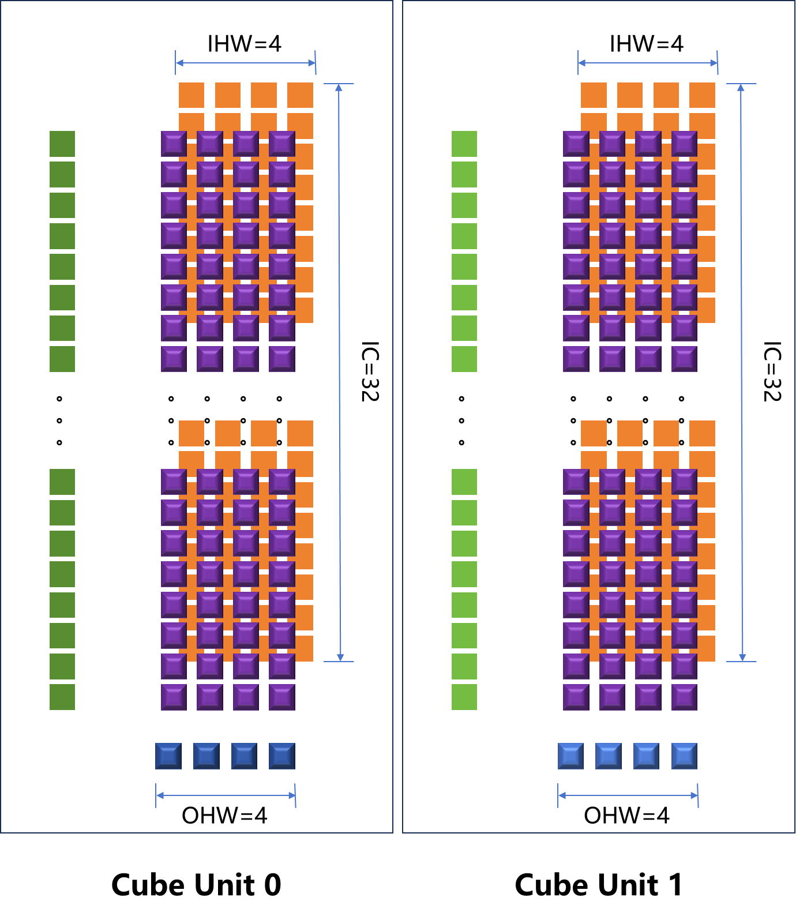
Cube in Compute Unit
Pseudocode for cube
for i in range(0, 32) //32 Cubes
O[on, oc+i, oh[0], ow[0]] = I[on, ic:ic+31, ih[0], iw[0]] .* K[ic:ic+31, oc+i, kh, kw] + O[on, oc+i, oh[0], ow[0]];
O[on, oc+i, oh[1], ow[1]] = I[on, ic:ic+31, ih[1], iw[1]] .* K[ic:ic+31, oc+i, kh, kw] + O[on, oc+i, oh[1], ow[1]];
O[on, oc+i, oh[2], ow[2]] = I[on, ic:ic+31, ih[2], iw[2]] .* K[ic:ic+31, oc+i, kh, kw] + O[on, oc+i, oh[2], ow[2]];
O[on, oc+i, oh[3], ow[3]] = I[on, ic:ic+31, ih[3], iw[3]] .* K[ic:ic+31, oc+i, kh, kw] + O[on, oc+i, oh[3], ow[3]];
Compute
Power
On average, one matrix multiplication can be calculated per clock cycle by CUBE module in each lane：
R 4*1 = OPA 4*32 * OPB 32*1 @INT8 (256 GOPS)
Data Reusability Analysis
OPA is reused at least 32 times
  by broadcasting OPA to 32 lanes.
OPB is reused at most 16 times
  by temporarily storing OPB in an register in the CUBE for a single load from local memory.
R is reused many times
  by storing in registers (totally 16 registers) for accumulation before finally write back to local memory.
Notes:
For example, when calculating with INT8 data precision, in the cube compute unit of each lane, a 4*32 left matrix is multiplied by a 32*1 right matrix through matrix multiplication, resulting in a 4*1 matrix.
Two inputs and one output are highlighted in orange, green, and purple respectively.
Such computation synchronously occurs in 32 LANEs .
And the temporary registers and reuse mechanisms designed for input and output data avoid data transfer becoming a performance bottleneck.

Slide 15
Important Factors for AI Oriented Computing
Memory
Control
ISA
Connect
Compute
Notes:
The fourth important factor is interconnection. As can be seen from the introduction above, to make it physically easy to implement, we divide the TPU's computing and storage modules into multiple LANE. So, how can we achieve efficient data transportation?

Slide 16
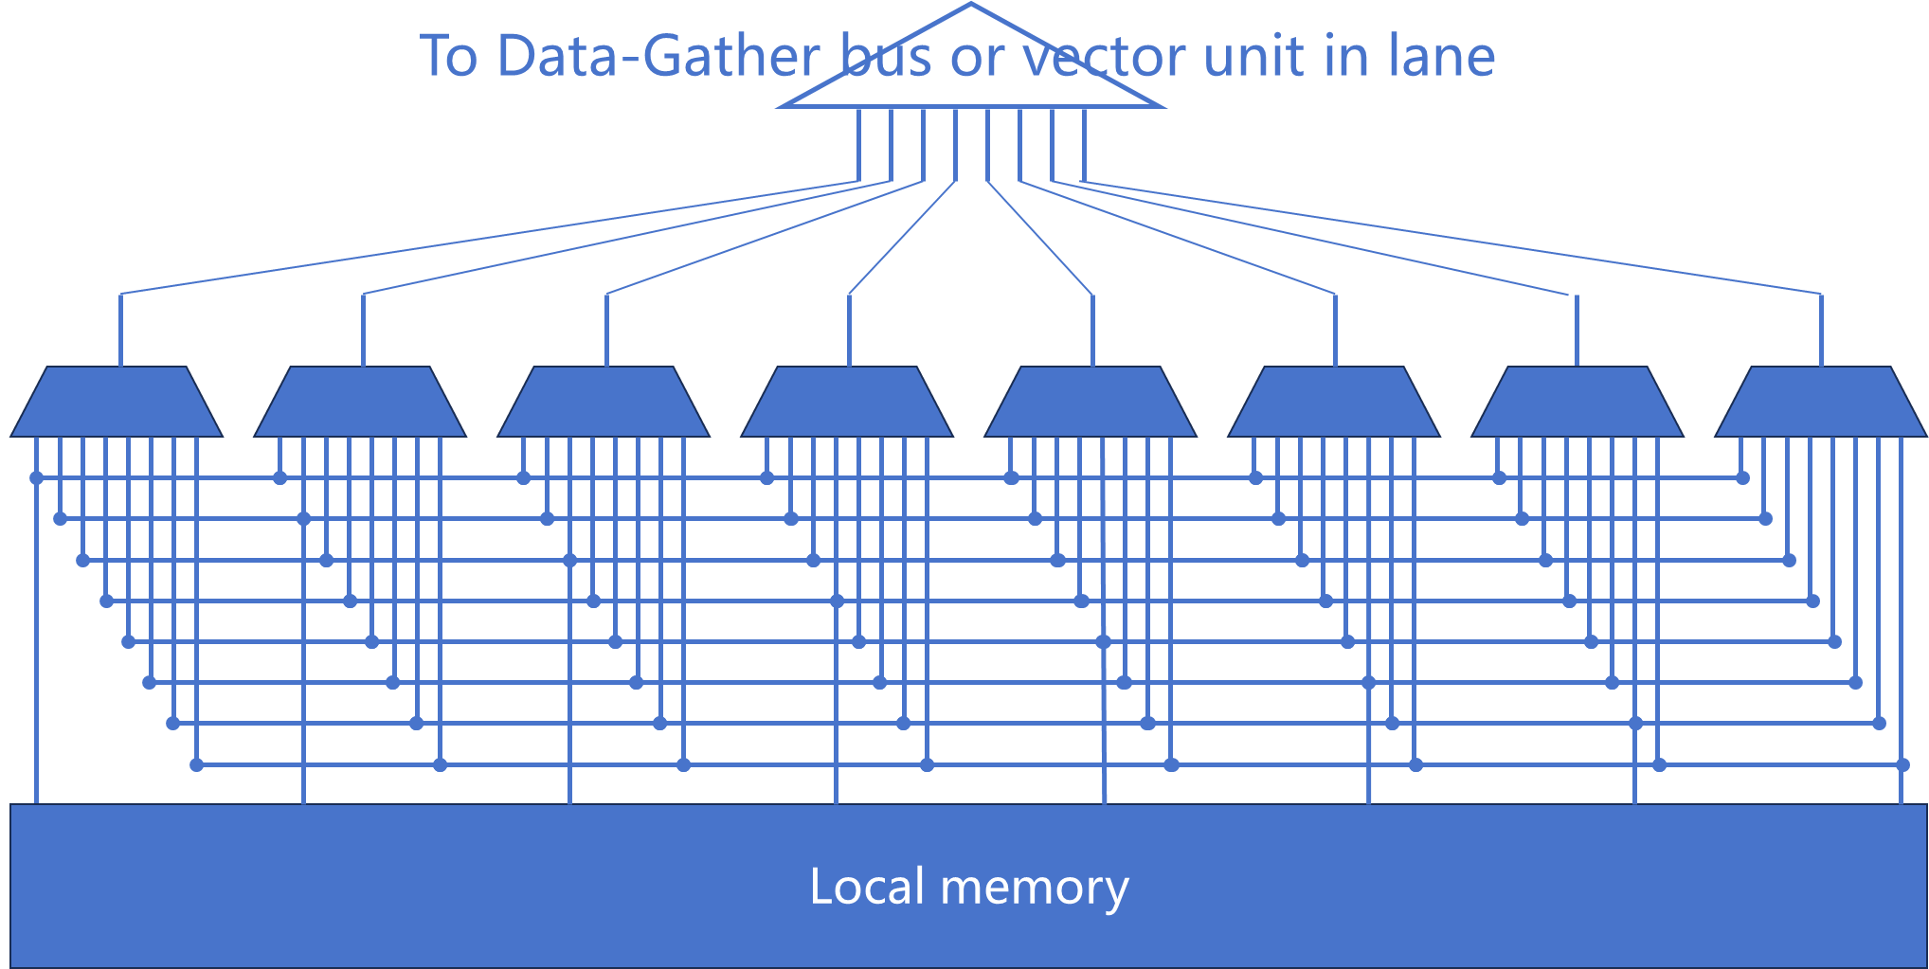
Data Path - Crossbar in Each Lane
Pseudocode for data gathering
ih[3:0] = F_ih(oh[3:0], kh, IH, T_PADDING, B_PADDING, IH_INSERT, H_STRIDE, KH, KH_DILATION);
iw[3:0] = F_iw(ow[3:0], kw, IW, L_PADDING, R_PADDING, IW_INSERT, W_STRIDE, KW, KW_DILATION);
……
for i in range(0, 32) //32 Cubes
O[on, oc+i, oh[0], ow[0]] = I[on, ic:ic+31, ih[0], iw[0]] ……
O[on, oc+i, oh[1], ow[1]] = I[on, ic:ic+31, ih[1], iw[1]] ……
O[on, oc+i, oh[2], ow[2]] = I[on, ic:ic+31, ih[2], iw[2]] ……
O[on, oc+i, oh[3], ow[3]] = I[on, ic:ic+31, ih[3], iw[3]] ……
The necessity of Crossbar
For convolution, each 2D activation tensor is stored continuously
In convolution, the IMG2COL process requires gathering non-aligned, non-continuous data
The performance of IMG2COL is crucial for the performance of some convolutional operators
Design scheme optimization
32 groups of 16-in 16-out @8bit crossbar are designed to replace 512-in 512-out @8bit crossbar
32x area reduction and timing improved
Notes:
As can be seen from the pseudocode above, convolution calculation involves simultaneously fetching 4 pieces of data from each LANE and forming a left matrix of 32*4.
Due to the special characteristics of convolution, the data gathering process for IMG2COL needs to be performed, and typically the data required is not aligned and continuous.
Therefore, we design a small-scale crossbar for data scatter and gather in each lane.

Slide 17
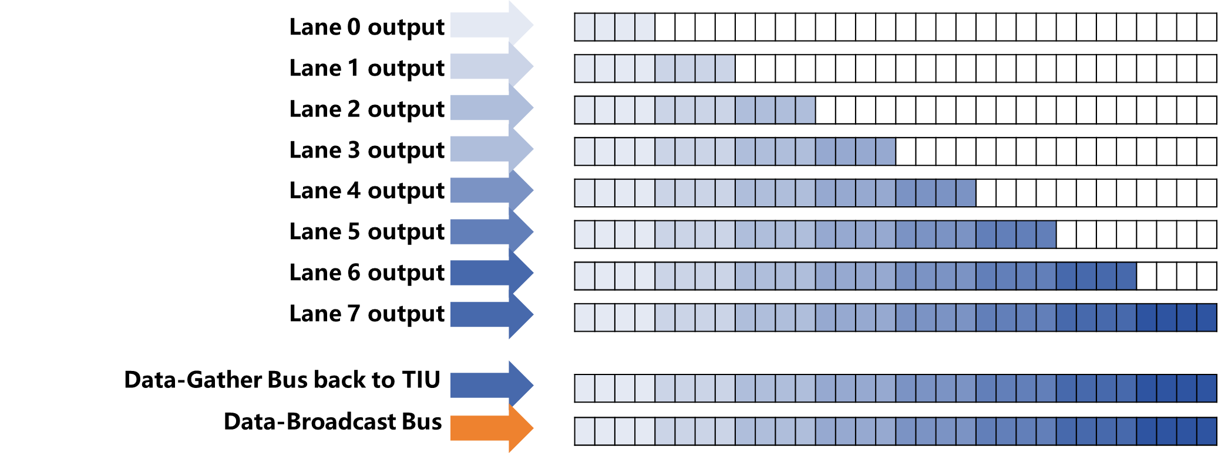
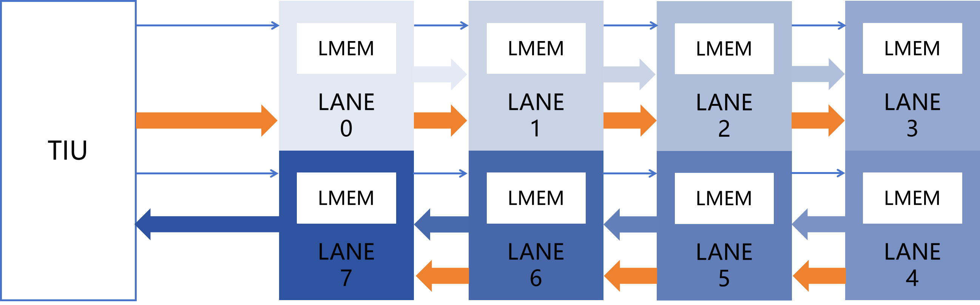
Ring Bus: Data-Gather & Data-Broadcast
Function and Performance
Pseudocode for data gathering & broadcasting
Gather 1024 bit @one clock cycle to TIU from 32 lanes each 32bit or from 8 lanes each 128bit
Broadcast 1024 bit @one clock cycle to all lannes
for i in range(0, 32)
O[on, oc+i, oh[0], ow[0]] = I[on, ic:ic+31, ih[0], iw[0]] .* K[ic:ic+31, oc+i, kh, kw] …
O[on, oc+i, oh[1], ow[1]] = I[on, ic:ic+31, ih[1], iw[1]] .* K[ic:ic+31, oc+i, kh, kw] …
O[on, oc+i, oh[2], ow[2]] = I[on, ic:ic+31, ih[2], iw[2]] .* K[ic:ic+31, oc+i, kh, kw] …
O[on, oc+i, oh[3], ow[3]] = I[on, ic:ic+31, ih[3], iw[3]] .* K[ic:ic+31, oc+i, kh, kw] …
Data Gather & Broadcast process
Design scheme
Notes:
The output data of crossbar in each lane is collected one by one through the data gather bus and finally transmitted to the TIU module.
The TIU then broadcasts this data to all lanes through the data broadcast bus.
The crossbar in each lane, data gather bus, and data broadcast bus are combined to achieve inter-lane efficient data transmission
This design provides better timing and saves tens of times the area compared to designing a large-scale crossbar that spans all lanes.

Slide 18
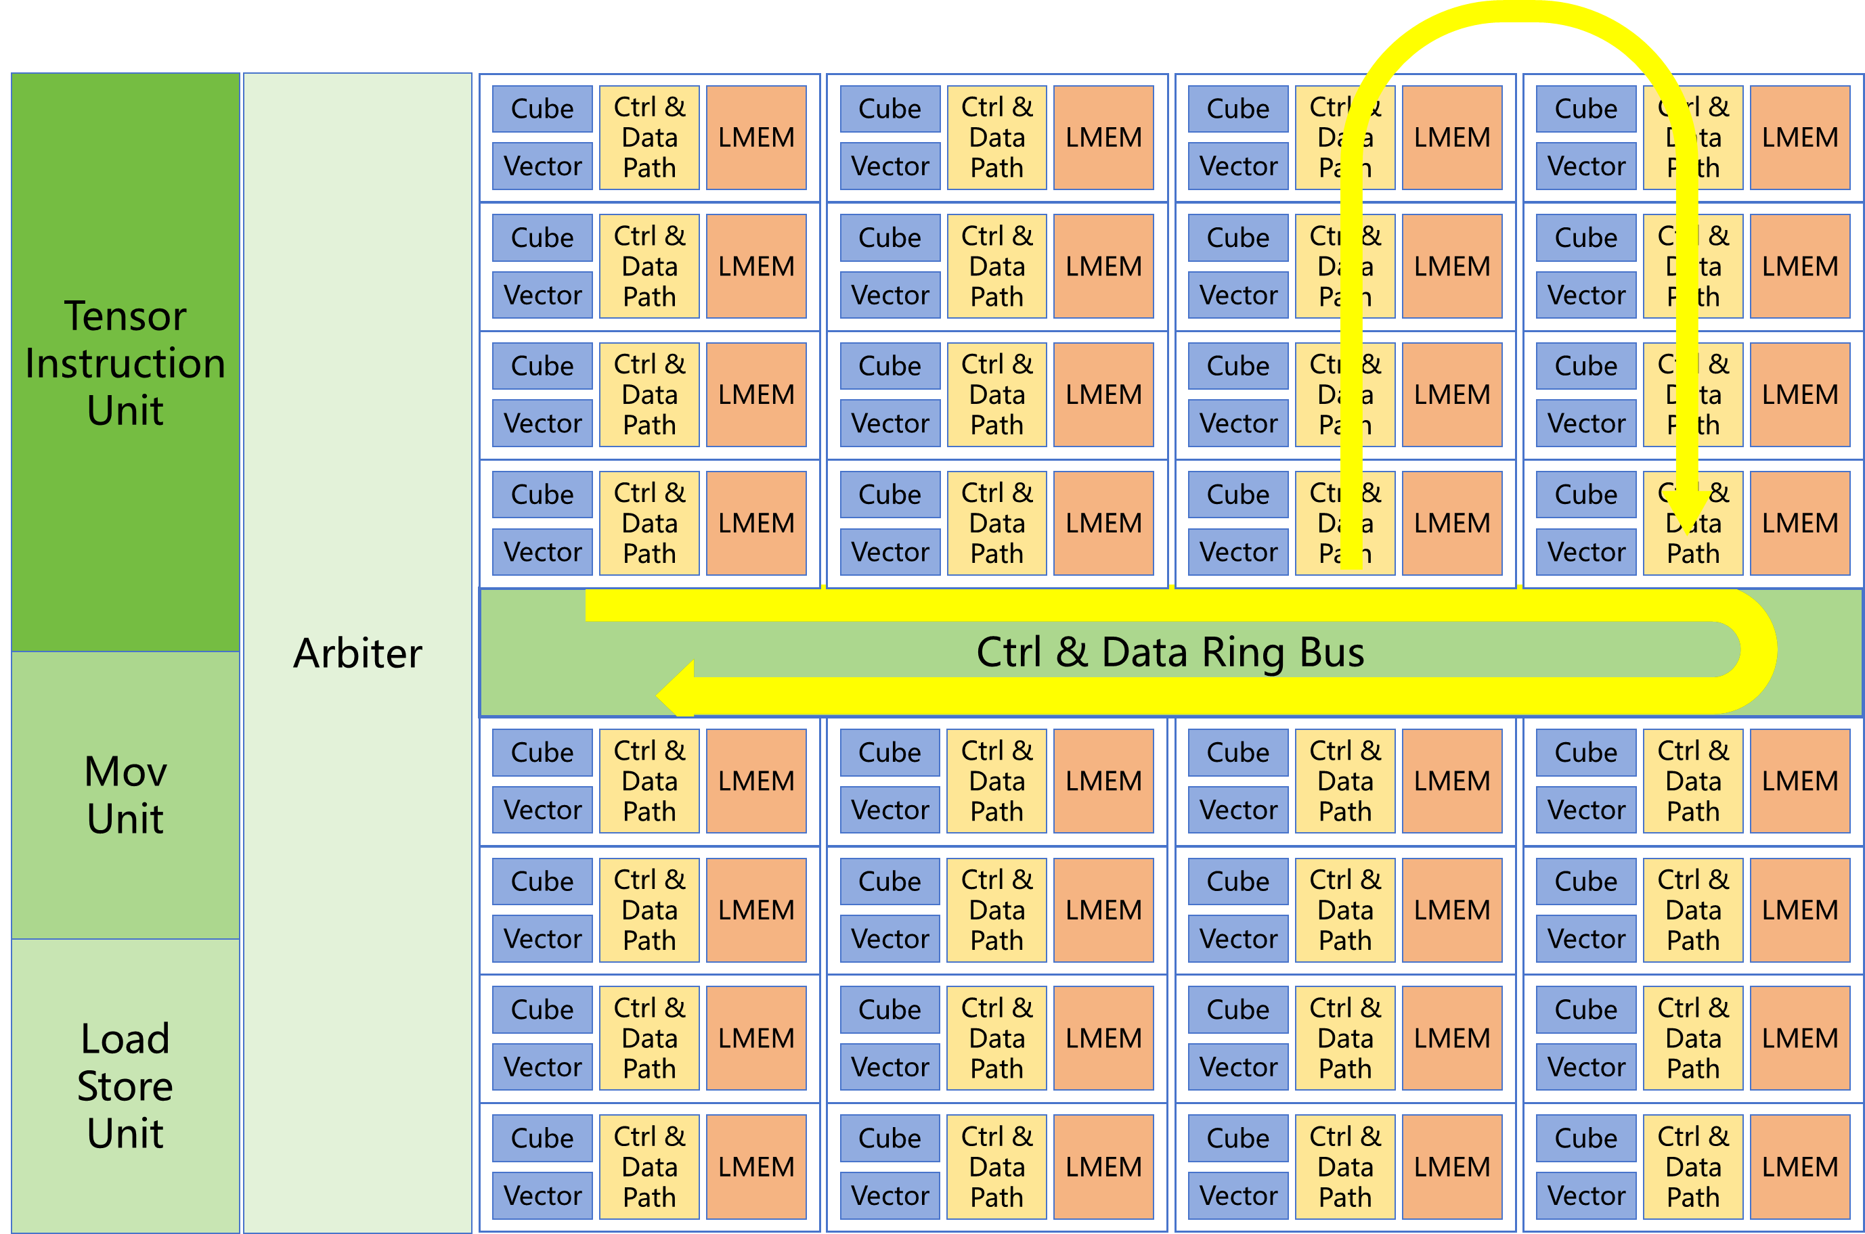
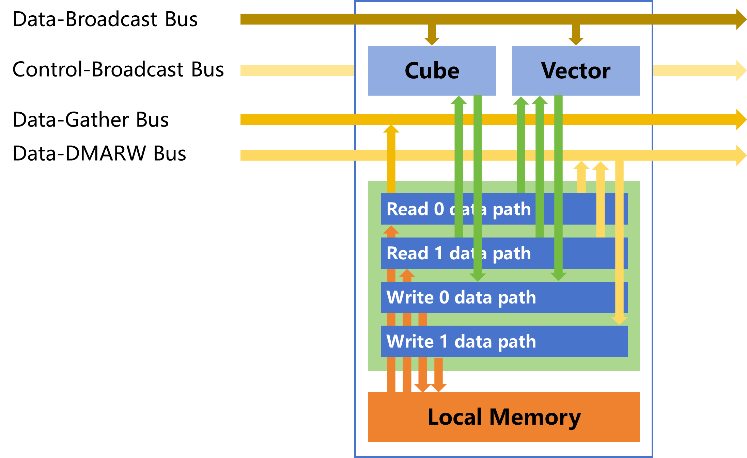
Ring Bus Overall View
4 Types Bus
Data-Broadcast Bus
Data-Gather Bus
Data-RW Bus
Control-Broadcast Bus
2-layer Ring Bus
Reducing transmission latency
Reducing area
No arbitration on bus
All arbitration completed within the TIU.
Simplifying design, saving space, improving timing
RTPU
LANE
Notes:
We adopt a dual-layer ring structure to reduce transmission delay and area.
What’s more, we place all arbitration within the TIU, eliminating the need for arbitration in any lane, which significantly simplifies the complexity of bus design and verification, and achieves improvements in timing and area.

Slide 19
Important Factors for AI Oriented Computing
Memory
Control
ISA
Connect
Compute
Notes:
The last important factor for AI oriented computing is memory. That is to say, how do we determine the specifications of DRAM.

Slide 20


Memory Choice
Comparison of Different DRAMs
Our Design Choice
256bit @6.4Gbps
Up to 128 GB
Bandwidth and capacity are important for running LLM.
Capacity is more important than bandwidth, considering the MOE trend of AI models.
LPDDR is the best choice for terminal: relatively big bandwidth, big capacity, low power and low cost.
Notes:
AI computing places higher demands on the bandwidth, capacity, cost, and power consumption of DRAM.
Based on the cost and power limitation of terminal chip, we design a 256-bit LPDDR5 to provide up to 200GB/s bandwidth and support up to 128GB of capacity.
This high bandwidth and capacity allow our SOC chip to support larger AI models and provide higher performance.

Slide 21
Multimodal Model Performance on OASIS
Model Name | Version | Param Type | Latency（ms）
Resnet50 | 2 | INT8 | 7.32 (batch size=16)
LLaMA | 2（7B） | INT4 | Decoder: 27.7
ChatGLM | 4（9B） | INT4 | Decoder: 39.46 Prefill: 1431.69
Qwen | 2（7B） | INT4 | Decoder: 49.67 Prefill: 1149.23
SAM encoder | ViT H/16 | FP16 | 166.76
Grounding-DINO | Swin-T | INT8 | 115.07
yolo | v8-s | INT8 | 3.97 (batch size=1) 29.30 (batch size=16)
yolo | v8-l | INT8 | 11.30 (batch size=1) 126.70 (batch size=16)
mobilenet | v3-large | INT8 | 2.30
Clip |  | INT8 | 5.66
ViT | Base | INT8 | 5.27
ViT | Large | INT8 | 51.92
Notes:
Finally, we evaluate the performance of various mainstream AI models on the SOC, and it can be seen that CNN, Transformer-based models can all achieve high performance support by the tensor extension instructions and the RTPU.
Additionally, we provide multiple quantization methods such as INT4, INT8, FP16, BF16 to ensure users can make a trade-off between precision and speed.

Slide 22
Thank you for watching
Notes:
That's all, thank you for watching and we are happy to take questions

